Slide 1
Support Vector machines
Derek Rice
INFO 523 – Data Mining and Discovery
Term Project
13-AUG-2023

Slide 2
Agenda
SVM - Classification with hyperplanes
A history of Support vector machines
linearly separable Case
linear Classification of the cats dataset
Nonlinearly separable Case
Separation in multidimensional vector space
Kernels for nonlinear classification
Review Cats dataset with “radial” and “polynomial” kernels
Introduce the letter recognition dataset
Linear classification with the “vanilladot” kernel
Non-linear classification with the “rbfdot” kernel
Optimization of the cost function “C”
Conclusions

Slide 3
Support Vector Machines are a machine learning algorithm used to classify instances within a dataset
SVM - Classification with Hyperplanes
Support Vector Machines are a machine learning algorithm used to classify instances within a dataset
The idea of Support Vector Machines is to separate classes within a dataset utilizing a hyperplane
In two dimensional space the hyperplane is simply a line
In three dimensional space the hyperplane is a plane
However, the idea is to place the hyperplane so as to center the plane between the data classes while maximizing the distance from the plane to the 1st instance of each class
The distance from the separating plane to the 1st instance of each class is called the margin
Only the instances adjacent to the margin are included in the solution. These inspaces are called the Support Vectors
Data points outside the margin are involved in calculating the SVM solution to the classification
Margin
hyperplane
Support vectors
Linear Separation in Two Dimensions

Slide 4
A history of support Vector machines
1960s: The fundamental idea behind SVMs can be traced back to the work of Vladimir Vapnik and Alexey Chervonenkis at the Institute of Control Sciences in Moscow. However, the work of Vapnik et. al. went unknown to the to the rest of the world until the early 1990’s when Vapnik immigrated to the United States and began a career at Bell Labs.
1992: Vladimir Vapnik publishes several papers. The innovation was in the use of a "maximal margin" hyperplane, which separates data into two classes in such a way that the margin between the hyperplane and the nearest data point from either class is maximized.
1995: The concept of the "kernel trick" was introduced separation of classes in multidimensional space
1998: Vapnik released his textbook “Statistical Learning Theory” providing the mathematical framework for Support Vector Machines and the creation of packages in R for the application of SVM to problems and datasets
early 2000s: The SVMs became one of the standard tools in machine learning and data mining.
Today: SVMs are still in the toolkit of many data scientists. Where deep neural networks require very large datasets SVM’s have unique strengths in classification, especially when working with non-image or non-sequential data. They continue to have applications in various domains, including bioinformatics, finance, and engineering mostly due to a strength in nonlinear classification and the utility of small datasets.

Slide 5
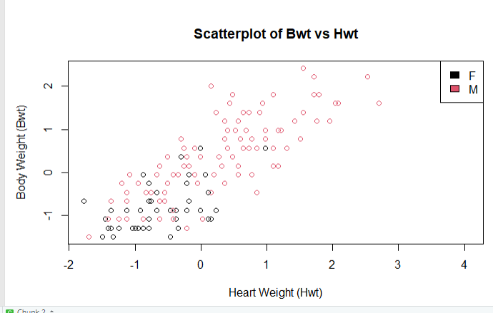
Scatterplot displays the overlap between the Male vs. Female classification in the Cats dataset
An Example – Mass Package – cats dataset
By way of example the Cats dataset in the MASS package is used here
The dataset is 144 instances
Response Y = Sex ~ male vs. female
There are two variables
X1 = Bwt = body weight in kilograms
X1 = Hwt = Heart weight in grams
Visually, using a scatterplot, female cats appear to have lower heart weight and lower body weight; however, there is significant overlap
Scatterplot of Cats dataset in the Mass Package

Slide 6

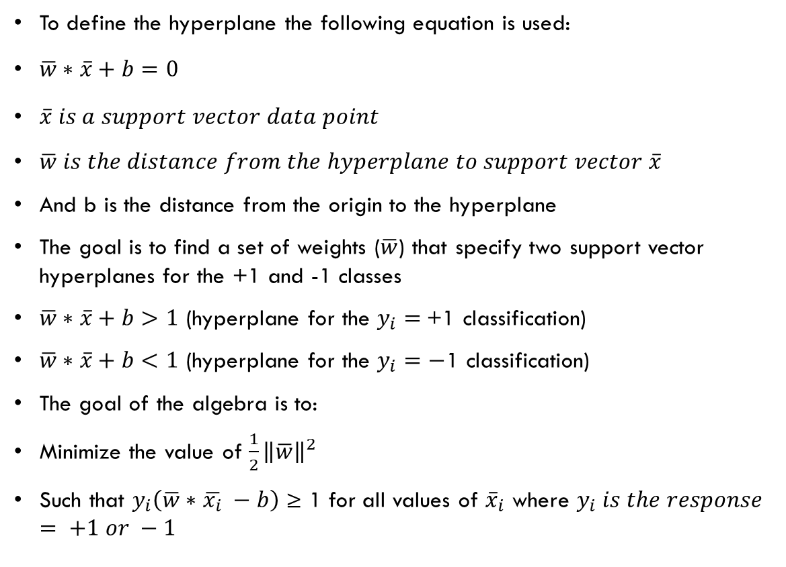



The goal of the SVM algorithm is to find the widest margin separating the two classes
linearly separable Case
To define the hyperplane the following equation is used:
$\overline{w}∗\overline{x}+b=0$
$\overline{x} is a support vector data point$
$\overline{w} is the distance from the hyperplane to support vector \overline{x}$
And b is the distance from the origin to the hyperplane
The goal is to find a set of weights ($\overline{w}$) that specify two support vector hyperplanes for the +1 and -1 classes
$\overline{w}∗\overline{x}+b>1$ (hyperplane for the $y_{i}=$+1 classification)
$\overline{w}∗\overline{x}+b<1$ (hyperplane for the $y_{i}=−$1 classification)
The goal of the algebra is to:
Minimize the value of $\frac{1}{2}{\left\|\overline{w}\right\|}^{2}$
Such that $y_{i}\left(\overline{w}∗\overline{x_{i}} −b\right)$ ≥ 1 for all values of ${\overline{x}}_{i}$ where $y_{i} is the response= +1 or −1$
Hyperplane “+1” class
Hyperplane “-1” class
$\overline{x}$’’
$$\overline{w}$$
$$\overline{w}$$
b
$\overline{x}$’
Support Vector Machine classification requires defining a hyperplane separating the two classes, and calculating the +1 and -1 hyperplanes with support vectors

Slide 7
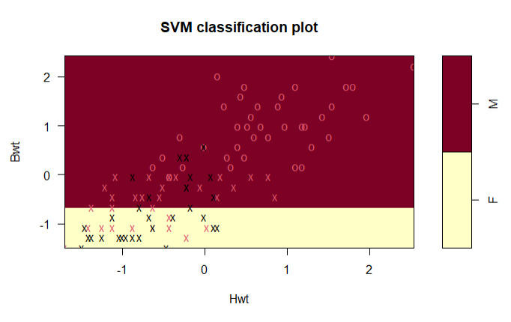
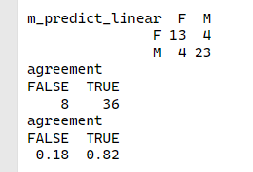
Only the Support Vectors, data points on the margin, participate in the solution
linear Classification of the cats dataset
Linear Separable Case
The SVM with a linear model separates the Cats dataset into its two classes
The dataset includes 144 instances
100 were used for training
44 were used to test the model
Of the 44 instances in the test dataset the SVM with a linear boundary classified 82% of the datapoints correctly
Support Vector Machine classification of Male and Female cats utilizing the Cats dataset in the Mass package
X = the support vectors - data points that lie on the margin
O = non-support vectors - lie outside the margin and do not participate in the solution

Slide 8
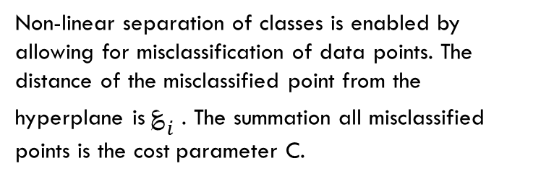
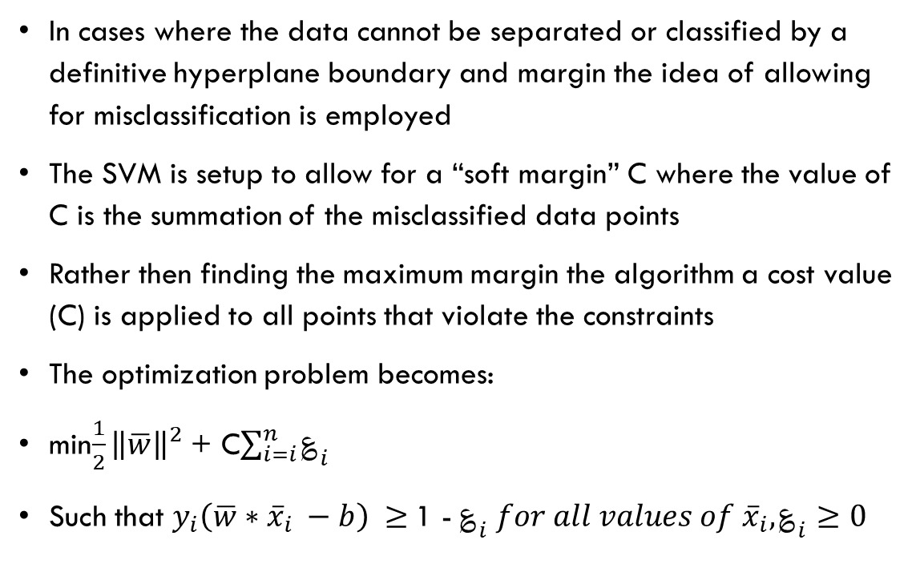
In the nonlinear separable case – misclassifications are allowed – the cost function C defines the maximum allowed error
Nonlinearly separable Case
In cases where the data cannot be separated or classified by a definitive hyperplane boundary and margin the idea of allowing for misclassification is employed
The SVM is setup to allow for a “soft margin” C where the value of C is the summation of the misclassified data points
Rather then finding the maximum margin the algorithm a cost value (C) is applied to all points that violate the constraints
The optimization problem becomes:
min$\frac{1}{2}{\left\|\overline{w}\right\|}^{2}$ + C$\sum_{i=i}^{n}{؏_{i}}$
Such that $y_{i}\left(\overline{w}∗{\overline{x}}_{i} −b\right) ≥$1 - $؏_{i} for all values of {\overline{x}}_{i}, ؏_{i}≥0$
؏_{i}
؏_{i}
Non-linear separation of classes is enabled by allowing for misclassification of data points. The distance of the misclassified point from the hyperplane is $؏_{i}$. The summation all misclassified points is the cost parameter C.

Slide 9
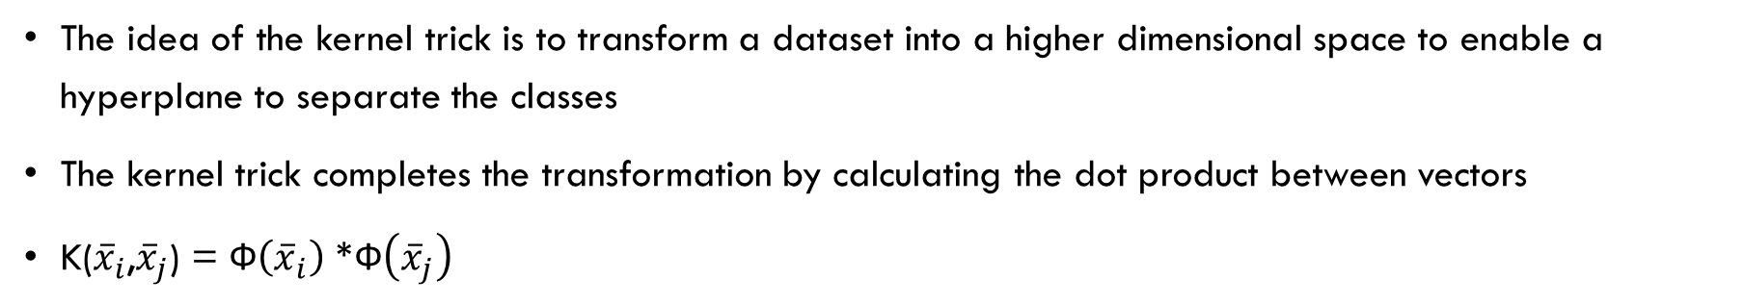
The kernal trick transforms a dataset to a higher dimensional space to enable a hyperplane to separate the classes
Separation in multidimensional vector space
X2
X3
Kernel trick Ф
hyperplane
Support vectors
X1
X1
The idea of the kernel trick is to transform a dataset into a higher dimensional space to enable a hyperplane to separate the classes
The kernel trick completes the transformation by calculating the dot product between vectors
K(${\overline{x}}_{i}$,${\overline{x}}_{j}$) = Ф$\left({\overline{x}}_{i}\right)$ *Ф$\left({\overline{x}}_{j}\right)$

Slide 10

Typically trail and error required to fit a kernel, its parameters, and a cost value C to a solution
Kernels for nonlinear classification
The linear kernel – does not transform the data
K(${\overline{x}}_{i}$,${\overline{x}}_{j}$) = ${\overline{x}}_{i} ∗ {\overline{x}}_{j}$
The polynomial kernel of degree d
K(${\overline{x}}_{i}$,${\overline{x}}_{j}$) = ${\left({ \overline{x}}_{i} ∗ {\overline{x}}_{j}+1\right)}^{d}$
The Gaussian RBF kernel
K(${\overline{x}}_{i}$,${\overline{x}}_{j}$) = $e^{\frac{−{\left\|{\overline{x}}_{i}−{\overline{x}}_{j}\right\|}^{2}}{2σ^{2}}}$

Slide 11
Conclusions
Support vector machines are effective at classification tasks where a hyperplane is positioned to best separate classes +1 vs. -1
Only data points on the “margin hyperplane” participate in the solution - these are the support vectors
The idea is to locate the hyperplane such that the margin (the distance from the hyperplane to the support vectors) is maximized
For the non-linear separable case misclassifications of datapoints are allowed
The parameter C – the cost function – is a summation of the maximum allowed misclassification
For data that cannot be separated in dataset dimensional space - kernal functions are leveraged to transform the data set to a higher dimensional space where a hyperplane can separate the classes
Kernal functions use a dot product between vectors to translate the dataset to the higher dimensional space
Computationally efficient compared to calculating higher dimensional values and adding those columns to a dataset
There are a number of kernal functions available each with a set of parameters
Typically trial and error is required to select the most appropriate kernal and parameters to train a model on a given dataset

Slide 12
references
Brett Lantz. Machine Learning with R 4th Edition. Packet Publisheing Ltd. Birmingham. UK. May, 2023.
Vladimir N. Vapnik. Statistical Learning Theory. John Wiley and Sons. Inc. New Delhi. 1998.
Bennett, KP and Campbell, C. Support Vector Machines: Hype or Hallelujah?, SIGKDD Explorations, 2000, Vol. 2, pp. 1-13.
Yaser S. Abu-Mostafa et. al. Learning from Data – A Short Course. AMLbook.com. 2012.

